Slide 1
Project report
Python for Data Analysis
Cédric HANSEN & Quentin GABOT
DIA3
2020/2021

Slide 2
Summary
Discussions about the dataset
  The initial assumptions
  State of the art
Representation & prediction
  Understand the dataset via the graphs
  Preprocessing
  The training phase
  The final tests
Computing the API
  API Flask
  Results

Slide 3
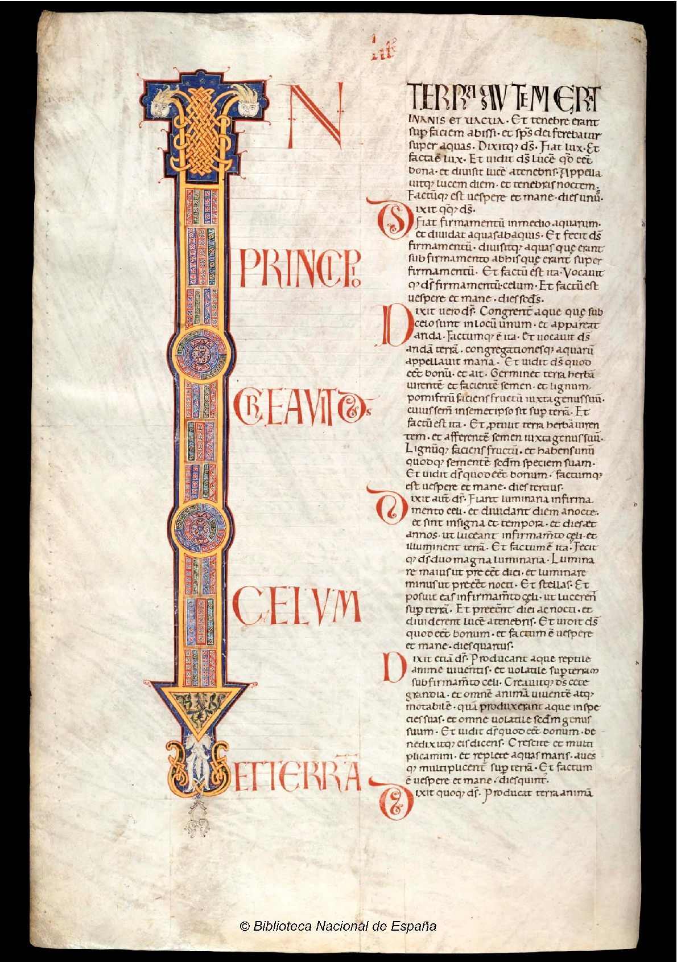

The initial assumptions
Our dataset is called the “Avila Bible”
  A corpus of texts written by 12 copyists
  The copyists are designated as a letter such as : $(A, B, C, D, E, F, G, H, I, W, X, Y)$
The dataset is described by its columns & rows
  Rows (or samples) = 4 consecutives sentences from the corpus
  Columns (or features) = variables that distinguish and allow us to predict the patterns’ authors
The dataset is split between 2 subsets
  The first one is the “train set” with 10430 samples
  We will train our models on this dataset
  The second is the “test set” with 10437 samples
  We will make our finals predictions on it : but which prediction ?

Slide 4

State of the art
The nature of the prediction
  Our objective is to assign each row from the test set to an author
  This assignation will be made by a model trained previously on the train set
The various prediction techniques
  Machine Learning is divided into two categories : supervised learning & unsupervised learning
  As we possess the output data, we are in the first situation : supervised learning
  Supervised learning is then divided into regression & classification
  As the response variable is qualitative, we are in the latter situation : classification
The classification models
  The classification is a very wide and rich field in terms of possibilities
  For this problem, we have retained some of the most famous and effective models
  Logistic Regression, KNN, Random Forest, Support Vectors Machines & Naïve Bayes
  We will select the one with the best accuracy i.e., the best ratio $\frac{good prediction}{total prediction}$

Slide 5
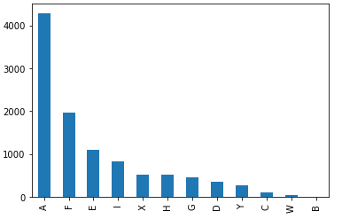
Understand the dataset via the graphs
The data visualization
  We decide to help our comprehension of the dataset with some graphs
  We have decided to implement three major graphs : boxplots, heatmap & pairplot
The consequences
  We have understood that the classes’ distribution is inequal
  Thus, our model will provide way more precision than a random classifier
  We have discovered that there was little to no relation between variables except for the last one : “modular ratio/interlinear spacing”
  Indeed, this variable is the combination of two other variables
  As such, we have decided to drop this variable

Slide 6
Preprocessing
The need for preprocessing
  If we directly jump into the training phase, we might skip some precious steps in order to deliver the best prediction possible
  For example, the data visualization has informed us that the variables weren’t scaled
  Thus, if we would have started the training phase without scaling the variables, the prediction would have suffered from this flaw
The preprocessing
  We have scaled the data like explained previously
  We have checked for any NAN values in order to treat this problem
  As there were none, we didn’t have to propose a solution

Slide 7
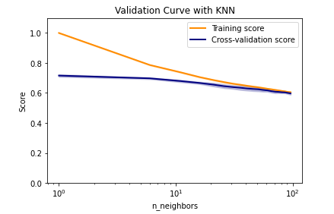
The training phase
The protocol
  The training phase will be divided into 5 phases corresponding to the 5 models that we will train
  Each phase we follow the exact same process : we compute the naïve model, we tune the hyperparameters thanks to the validation curve in order to determine which one is interesting to manipulate and we finally use a RandomSearchCV to determine the best values for each hyperparameters
The validation curve
  The validation curve allows us to visualize a more precise interval for each quantitative hyperparameters in order to save us time and gain in precision before the Grid Search
  This curve also helps us to avoid any case of overfitting by being vigilant of the difference between the CV score et the Train scoree
  Sometimes, the validation curve shows us that a variable remains invariant: this is the case for the “leaf_size” du model KNN
  We then drop this hyperparameter as its default value is already the best one

Slide 8
The final tests
The final test
  The final test consists of testing every model on the test set
  As we do so, we pick the best accuracy value representing the most efficient model
  This model is the Random Forest with an impressive 99,95% accuracy

Slide 9
API Flask
Setting the API
  Create new environment
  Library: Flask, Bootstrap, Wtform
How it works
  Creates form where we add each variable
  Check the validity of each variable
  Use our model on the input variable
  Show the prediction

Slide 10
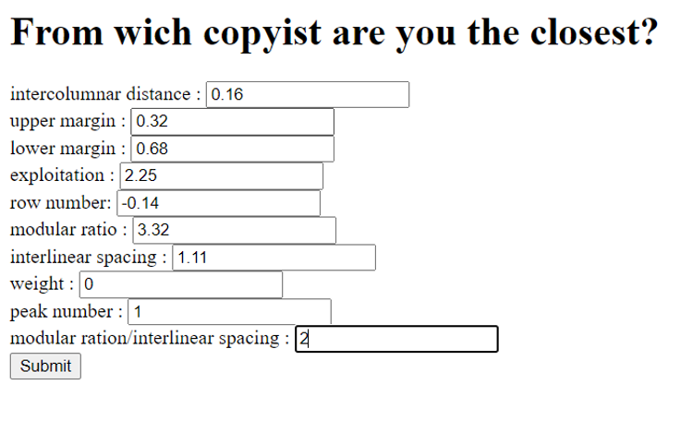
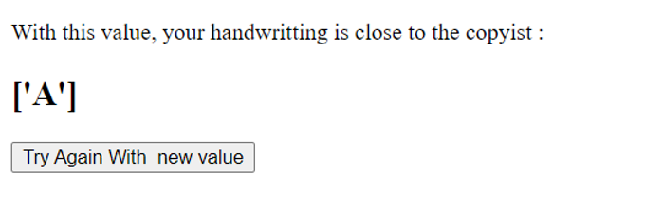
Results
Second page: Result
First page: Form

